Slide 1
Image Compression
Chapter 8 (B)
Imran Siddiqi
imran.siddiqi@mcs.edu.pk
Computer Science Department
College of Telecommunication Engineering
National University of Sciences and Technology

Slide 2
Basic compression methods
Huffman coding
Golomb coding*
Arithmetic coding
LZW coding
Run length coding
Symbol-Based coding *
Bit-Plane coding *
Block transform coding *
Predictive coding (lossy and loss less)*
Wavelet coding*
* will not be covered in this course

Slide 3
Huffman coding
Named after Huffman, 1952
The most popular technique for removing coding redundancy; yields the smallest possible number of code symbols per source symbol
Variable length code
Error-free compression technique
Reduce only coding redundancy by minimizing the L_{avg} and assign shorter code words to the most probable gray levels

Slide 4
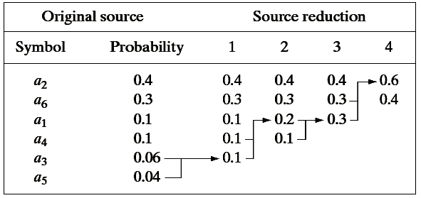
Huffman coding algorithm
Arrange the symbol probabilities p_{i} in a decreasing order; consider them (p_{i}) as leaf nodes of a tree
While there is more than one node:
  Merge the two nodes with smallest probability to form a new node whose probability is the sum of the two merged nodes
  Arrange the combined node according to its probability in the tree
  Repeat until only two nodes are left

Slide 5
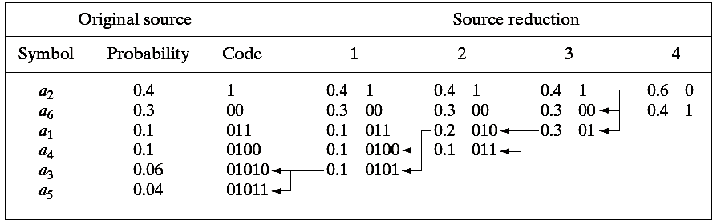
Huffman coding algorithm
Starting from the top, arbitrarily assign 1 and 0 to each pair of branches merging into a node
Continue sequentially from the root node to the leaf node where the symbol is located to complete the coding
Lavg = (0.4)(1) + (0.3)(2) + (0.1)(3) + (0.1)(4) + (0.06)(5) + (0.04)(5) = 2.2 bits/pixel

Slide 6
Huffman (de)coding
Consider the following encoded strings of code symbols
010100111100
The sequence can be decoded by just examining the string from left to right
010100111100
a₃a₁a₂a₂a₆

Slide 7
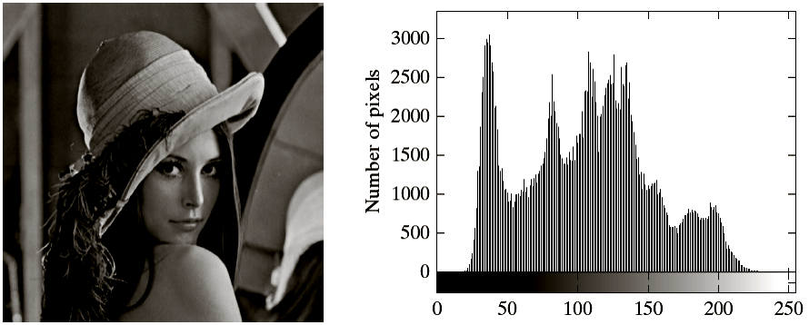
Huffman Coding: Example
Huffman code length = 7.428 bits/pixel
Compression Ratio (C) = 7.428/8 = 1.077
Relative Redundancy (R) = 1 – 1/1.077 = 0.0715 = 7.15%

Slide 8
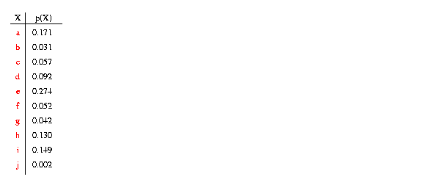
Huffman Coding

Slide 9
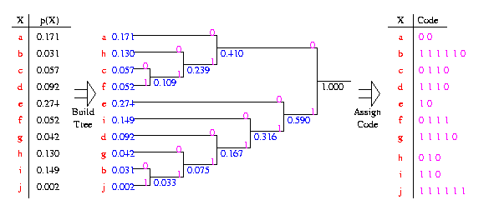
Huffman Coding

Slide 10
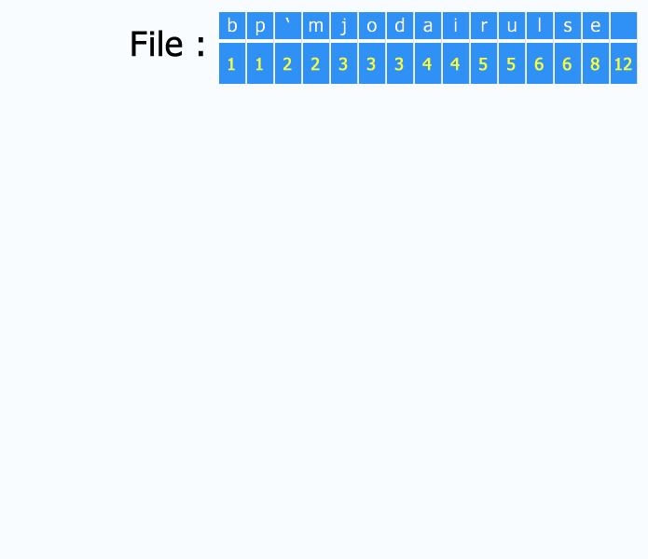
Huffman Coding

Slide 11
Arithmetic coding
Variable length code
Error-free compression technique
An entire sequence of source symbols is assigned a single arithmetic code word
  one-to-one correspondence between source symbol and code word does not exist
Due to above property, this coding can achieve theoretically higher compression rates than Huffman codes

Slide 12
Arithmetic coding
The code word defines an interval of real numbers
in the range 0 and 1
Each symbol of the message reduces the size of the
interval in accordance with its probability of occurrence
Set low to 0.0 Set high to 1.0
While there are still input symbols do
Get an input symbol code_
range = high - low.
high = low + range*high_range(symbol)
low = low + range*low_range(symbol)
End of While
output low

Slide 13
Arithmetic coding
Symbol | Probability | Range
a | .2 | [0,0.2)
e | .3 | [0.2, 0.5)
i | .1 | [0.5, 0.6)
o | .2 | [0.6, 0.8)
u | .1 | [0.8, 0.9)
! | .1 | [0.9, 1)

Slide 14
Set low to 0.0 Set high to 1.0
While there are still input symbols do
Get an input symbol code_
range = high - low.
high = low + range*high_range(symbol)
low = low + range*low_range(symbol)
End of While
output low
Symbol | Probability | Range
a | .2 | [0,0.2)
e | .3 | [0.2, 0.5)
i | .1 | [0.5, 0.6)
o | .2 | [0.6, 0.8)
u | .1 | [0.8, 0.9)
! | .1 | [0.9, 1)
After
seeing
e
a
i
i
!
1
0.5
0.26
0.236
0.2336
!
0.2336
!
!
!
!
!
0.9
u
u
u
u
u
u
0.8
o
o
o
o
o
o
0.6
i
i
i
i
i
i
0.5
e
e
e
e
e
e
0.2
a
a
a
a
a
a
0
0.2
0.2
0.23
0.233
0.23354

Slide 15
Arithmetic Decoding
Symbol | Probability | Range
a | .2 | [0,0.2)
e | .3 | [0.2, 0.5)
i | .1 | [0.5, 0.6)
o | .2 | [0.6, 0.8)
u | .1 | [0.8, 0.9)
! | .1 | [0.9, 1)
Get encoded number
Do
find symbol whose range straddles the encoded number output the symbol
range = symbol high value - symbol low value
subtract symbol low value from encoded number
divide encoded number by range
until no more symbols
The decoder gets the final number :
0.23354
The number lies entirely within the space the model allocate for e
first character was e

Slide 16
Get encoded number
Do
find symbol whose range straddles the encoded number output the symbol
range = symbol high value - symbol low value
subtract symbol low value from encoded number
divide encoded number by range
until no more symbols
Symbol | Probability | Range
a | .2 | [0,0.2)
e | .3 | [0.2, 0.5)
i | .1 | [0.5, 0.6)
o | .2 | [0.6, 0.8)
u | .1 | [0.8, 0.9)
! | .1 | [0.9, 1)
The decoder gets the final number :
0.23354
The number lies entirely within the space the model allocate for e
Apply decoding
  Range = 0.5 -0.3 = 0.2
  Encoded number = 0.23354 – 0.2 = 0.03354
  New number = 0.03354 /0.3= 0.1118
The range lies entirely within the space the model allocate for a
first character was e
second character was a
….

Slide 17
Get encoded number
Do
find symbol whose range straddles the encoded number output the symbol
range = symbol high value - symbol low value
subtract symbol low value from encoded number
divide encoded number by range
until no more symbols
Symbol | Probability | Range
a | .2 | [0,0.2)
e | .3 | [0.2, 0.5)
i | .1 | [0.5, 0.6)
o | .2 | [0.6, 0.8)
u | .1 | [0.8, 0.9)
! | .1 | [0.9, 1)
Encoded Symbol | Output Symbol | Low | High | Range
0.23354 | e | 0.2 | 0.5 | 0.3
0.1118 | a | 0 | 0.2 | 0.2
… | … | … | … | …

Slide 18
Lempel-Ziv-Welch (LZW) coding
An error-free compression technique
Removes spatial redundnacy
Assign fixed-length code words to variable length sequences of source symbols
It does not require any knowledge of probability of occurrence
LZW coding is used in the GIF, TIFF and PDF formats

Slide 19
LZW Encoding Algorithm
Initialize the dictionary to contain all blocks of length one
Search for the longest block W which has appeared in the dictionary.
3. Encode W by its index in the dictionary.
4. Add W followed by the first symbol of the next block to the dictionary.
5. Go to Step 2.

Slide 20
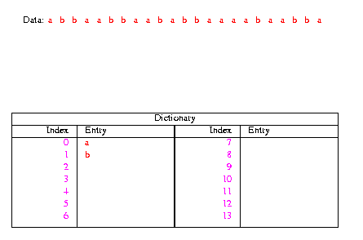
LZW Encoding Algorithm
1. Initialize the dictionary to contain all blocks of length one (D={a,b}).
2. Search for the longest block W which has appeared in the dictionary.
3. Encode W by its index in the dictionary.
4. Add W followed by the first symbol of the next block to the dictionary.
5. Go to Step 2.

Slide 21
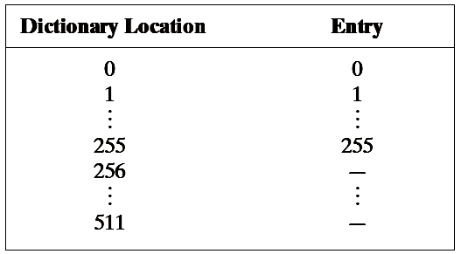
LZW Encoding – Images
Images are scanned from left to right and from top to bottom
A codebook or dictionary containing the source symbols to be coded is constructed on the fly
For 8-bit monochrome images, first 256 words of the dictionary are assigned to intensities 0,1,2,3,…,255.

Slide 22
LZW Encoding – Images
During the encoding process, intensity sequences that are not in the dictionary are placed in algorithmically determined locations e.g. a sequence of two-white pixels (255-255) may be assigned the location 256 in the dictionary

Slide 23
LZW Encoding – Images
The next time that two consecutive white pixels are encountered, codeword 256 (the address of the location containing 255-255) is used to represent them
If 9-bit, 512-word dictionary is employed then two pixels (16 bits) can be represented by 9 bits only

Slide 24
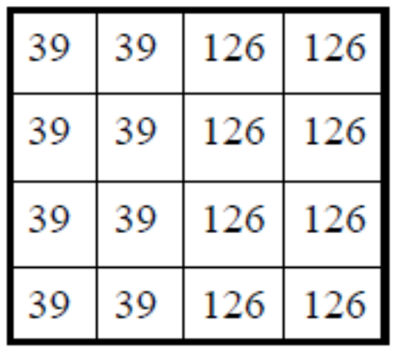
LZW Encoding – Images
Image is scanned from left to right and from top to bottom OR consider it as a vector
Image: 39 39 126 126 39 39 126 126 39 39 126 126 39 39 126 126
Dictionary Location | Entry
0 | 0
1 | 1
… | …
255 | 255
256 | -
257 | -
… | -

Slide 25
LZW Encoding – Images
Image: 39 39 126 126 39 39 126 126 39 39 126 126 39 39 126 126
Encoded Output: 39
39
126
126
256
258
260
259
257
126
Dictionary Location | Entry
0 | 0
1 | 1
… | …
255 | 255
256
257
258
259
260
261
262
263
264
39 – 39
39 – 126
126 – 126
126 –39
39 – 39 – 126
126 – 126 – 39
39 – 39 – 126 – 126
126 – 39 – 39
39 – 126 – 126

Slide 26
LZW - Decoding
Given the encoded (output) data, and the initial dictionary values
  Do not need the entire dictionary.
For each output symbol encountered
  Replace with the input sequence from the dictionary
  And, create new entry in the dictionary

Slide 27

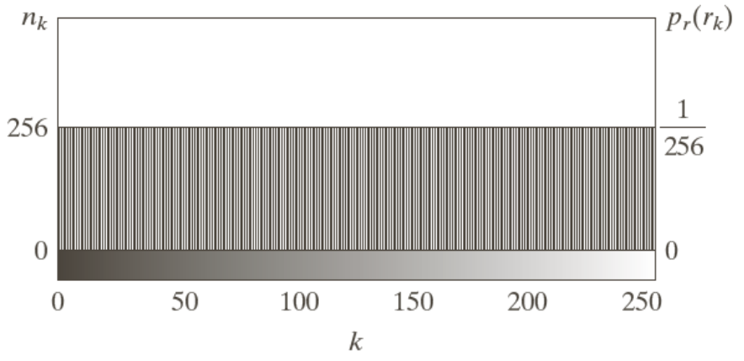
Run Length Encoding
Recall
Image features
  All 256 gray levels are equally probable → uniform histogram
  (variable length coding can not be applied)
  The gray levels of each line are selected randomly so pixels are independent of one another in vertical direction
  Pixels along each line are identical, they are completely dependent on one another in horizontal direction
A computer generated (synthetic) 8-bit image
M = N = 256
Spatial redundancy

Slide 28
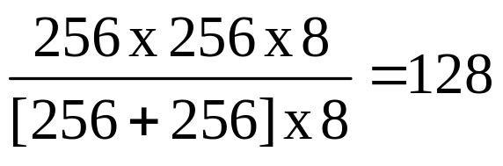
Run Length Encoding
Recall
The spatial redundancy can be eliminated by using run-length pairs (a mapping scheme)
Run length pairs has two parts
  Start of new intensity
  Number of consecutive pixels having that intensity
Example (consider the image shown in previous slide)
  Each 256 pixel line of the original image is replaced by a single 8-bit intensity value
  Length of consecutive pixels having the same intensity = 256
  Compression Ratio =

Slide 29
RLE – Binary Images
Run-length Encoding is also effective in case of binary images
Adjacent pixels in binary images are more likely to be identical
  Scan an image row from left to right and code each contiguous group (i.e. run) of 0s or 1s according to its length
  Establish a convention to determine the value of the run
Common conventions are
  To specify the value of the first run of each row
  To assume that each row begins with a white run, whose run length may in fact be zero

Slide 30
RLE – Binary Images
Example:
Specify the value of the first run of each row:
  0525181125: gray level of the first run is ‘0’ (black)
Assume each row begins with a white run (bit ‘1’):
  0525181125: length of the first (white) run is 0
000001100000100000000101100000 (30 bits in a row)

Slide 31
References
Chapter #8: Digital Image Processing by Rafael C. Gonzales & Richard E. Woods

